Slide 1
Qualicum School District Board Trustees Frank Clegg Chairman and CEO Canadians for Safe Technology
Sept. 28, 2021
frank@c4st.org

Slide 2
Bio and Organization’s Focus
President of Microsoft Canada – Most recent position
40+ years in the technology industry
Focused on children’s internet safety since 2004
C4ST: Canadians for Safe Technology (CEO and Chairman)
Not-for-profit, volunteer-based, national coalition of parents, citizens and experts
To educate & inform Canadians – dangers of exposures to radiation from wireless technology
To work with all levels of government to create healthier communities for children and families from coast to coast to coast.
Environmental Health Trust (Co-Chairman Business Advisory Group)
The only nonprofit in the world today that both:
Carries out research on controllable environmental health hazards, and
Works directly with local communities, teachers, parents & students as well as policy makers to understand & mitigate these hazards through research, education & advocacy.

Slide 3
Health Effects from wireless radiation
Thousands of peer-reviewed studies have shown that
RF radiation affects living organisms at levels
well below North America’s guidelines. ¹
Proven effects include:
increased cancer risk
sperm damage and other reproductive harms
DNA damage
neurological disorders (Alzheimer's, etc.)
learning and memory deficits (childhood development)
cellular stress
increase in harmful free radicals
¹https://c4st.org/wp-content/uploads/2020/05/Supplemental-Material-for-Suspend-5G-Canada-Appeal.pdf
Notes:
The appendix contains many slides you can chose to provide more information on.
National Toxicology Program. Cell Phone Radio Frequency Radiation https://ntp.niehs.nih.gov/results/areas/cellphones/index.html
Falcioni, L., et al. (2018). Report of final results regarding brain and heart tumors in Sprague-Dawley rats exposed from prenatal life until natural death to mobile phone radiofrequency field representative of a 1.8 GHz GSM base station environmental emission. Environmental Research. https://doi.org/10.1016/j.envres.2018.01.037 https://www.sciencedirect.com/science/article/pii/S0013935118300367?via%3Dihub
Pall, M. L. (2015). Scientific evidence contradicts findings and assumptions of Canadian Safety Panel 6: microwaves act through voltage-gated calcium channel activation to induce biological impacts at non-thermal levels, supporting a paradigm shift for microwave/lower frequency electromagnetic field action. Reviews on Environmental Health, 30(2), 99–116. https://doi.org/10.1515/reveh-2015-0001
Canadian scientists urge more research into safety of wireless technology, saying recent report downgrades cancer risk. The National Post. April 15, 2014. https://nationalpost.com/health/canadian-scientists-urge-more-research-into-safety-of-wireless-technology-saying-recent-report-downgrades-cancer-risk
https://www.powerwatch.org.uk/science/studies.asp
https://bioinitiative.org/conclusions/
https://www.saferemr.com/2014/08/why-we-need-stronger-cell-phone_43.html

Slide 4
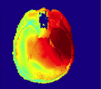
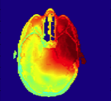
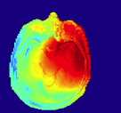
Children Are not “Little Adults”
3 Year Old 6 Year Old 34 Year Old
HIGH
LOW
Not to scale. Fernandez,, de Salles, Davis (2015)
Thinner skulls, smaller heads (shorter distance to brain centers)
Different dielectric properties (higher liquid content)
Brains are less myelinated and still developing
Notes:
There are 2 other slides on

Slide 5
Legislation and Recommendations to reduce RF exposure
In the United States:
The Collaboration for High-Performance Schools (CHPS)¹
The New Jersey Educational Association²
The Maryland Children’s Environmental Health and Protection Advisory Council³
United Educators of San Francisco (UESF)⁴
New York State Teachers Union (NYSUT) ⁵
France⁶, Greece⁷, Italy⁸ and Taiwan⁹
The Ontario English Catholic Teachers Association (OECTA) ¹⁰
The Canadian Teachers' Federation ^{11,12}
More than 40 Canadian medical doctors and a further 50 international scientists
Over 255 scientists from 44 nations, appealed to the UN, WHO and all member States¹³
See Appendix for reference url’s
Notes:
This may be overkill, but Riina said she wanted lots of references

Slide 6
Other Concerns with Wireless 5G
There has been no health safety testing on 5G’s long term effects
Wireless 5G will cause more immediate health effects on 3% to 10% of people.
Wireless technologies impact wildlife: birds, pollinators and plants.
Climate change and pollution will be considerably impacted by wireless 5G.
Risk to personal and business privacy will increase with 5G wireless networks.
The economic burden of 5G has not been adequately evaluated.
Weather forecast accuracy can be impacted by 5G satellite interference.
Notes:
what is 5G and the health effects of it; tracking/surveillance that comes with 5G, how agenda 2030 (reset education/ implimitation of 5G based on World Economic Forum) how it is all connected; kids now days in schools with wifi; what we can do or what has been done in Canada to stop rollout of 5G; solutions/tips

Slide 7
North America’s Abysmal Track Record
Asbestos Bisphenol-A (BPA)
Cigarette smoking Thalidomide
Urea formaldehyde insulation Flame retardants
Lead Mercury
Concrete action was not taken until
decades after
the original science showing harm was
peer reviewed and published.
“Health Canada's Food Directorate has concluded that the current dietary exposure to BPA through food packaging uses is not expected to pose a health risk to the general population including newborns and infants” 1
1https://www.canada.ca/en/health-canada/services/food-nutrition/food-safety/packaging-materials/bisphenol.html

Slide 8
Suggested Actions
Continue your personal education
Investigate methods to reduce radiation levels within schools
Linbrook School, Oakville, ON
Building science and radiofrequency radiation: What makes smart and healthy buildings¹
Collaborative for High Performance Schools (CHPS) ²
The New Jersey Educational Association³
Maryland Children's Environmental Health and Protection Advisory Council⁴
All new schools and/or major renovations should rough-in hard wiring throughout
Educate students, teachers, parents and staff how to provide a safe environment at home to allow for rejuvenation and repair
Support our concerns with town Councillors re 5G towers and antennas
¹ https://www.sciencedirect.com/science/article/pii/S0360132319305347?via%3Dihub
² https://chps.net/us-chps-criteria
³ https://www.njea.org/minimize-health-risks-from-electronic-devices/
⁴ https://phpa.health.maryland.gov/OEHFP/EH/Pages/WiFiCEHPAC.aspx

Slide 9
Appendix

Slide 10
Legislation and Recommendations - references
¹https://chps.net/us-chps-criteria (accessed January 18, 2019).
²https://www.njea.org/minimize-health-risks-from-electronic-devices/ (accessed January 18, 2019).
³https://phpa.health.maryland.gov/OEHFP/EH/Pages/WiFiCEHPAC.aspx (accessed January 18, 2019).
⁴http://www.uesf.org/san-francisco-educators-pass-resolution-calling-for-safer-technology-standards-for-all-san-francisco-schools/
⁵https://www.prnewswire.com/news-releases/guidelines-for-safer-use-of-wireless-technology-in-classrooms-published-300054729.html
⁶http://www.complianceandrisks.com/france-publishes-law-on-electromagnetic-waves/
⁷https://www.gsma.com/publicpolicy/base-station-planning-permission-in-europe
⁸http://www2.landtag-bz.org/de/datenbanken/akte/angaben_akt.asp?pagetype=fogl&app=idap&at_id=346630&blank=Y
⁹http://www.dailymail.co.uk/news/article-2929530/Does-toddler-play-iPad-Taiwan-makes-ILLEGAL-parents-let-children-two-use-electronic-gadgets-18s-limit-use-reasonable-lengths.html
¹⁰ http://www.oecta.on.ca/wps/portal/! http://www.safeschool.ca/uploads/WiFipositionpaper2.pdf
¹¹ http://www.canadianteachermagazine.com/issues/2015/CTM_JanFeb15/index.html
¹² http://www.ctf-fce.ca/en/Pages/Issues/Wi-Fi-Briefing-Document.aspx
¹³https://emfscientist.org/
Notes:
This may be overkill, but Riina said she wanted lots of references

Slide 11
Protect Yourself and Your Family
Distance is your friend
Don’t sleep with your cell phone.
Keep cell phones away from your head and out of your pocket, bras, etc.
Keep cell phones and tablets away from small children.
Mothers to be: keep all wireless devices away from your abdomen.
Do not use personal “wearable” wireless devices in transmitting mode.
Select appliances/devices that have a wired option.
Create a safe-haven in your residence
Remove all cordless phones.
Opt out of continuously transmitting smart utility meters.
Replace wireless home Wi-Fi with wired options. If impossible, put the router on a timer to turn off at night. Remove from high-use and sleeping areas.
Replace a wireless baby monitor with a wired monitor.
If you don’t want a 5G antenna near you, stop streaming videos wirelessly
Notes:
Research for health effects, but new products that are hard wired - $66.6m - Msft, alphabet, apple; cisco; Samsung
Default settings – privacy on, wired on, lower radiation (routers and phones)
Google presentation – receptive – phone turns off if near your head, reduced power defaults,
All tablets providing hard wire connection
Easier to use head phones (non bluetooth)

Slide 12
Websites for additional information
Canadians for Safe Technology (C4ST). https://C4ST.org
Environmental Health Trust. https://Ehtrust.org
Electromagnetic Radiation Safety. https://www.saferemr.com/
Physicians for Safe Technology. https://Mdsafetech.org
Notes:
what is 5G and the health effects of it; tracking/surveillance that comes with 5G, how agenda 2030 (reset education/ implimitation of 5G based on World Economic Forum) how it is all connected; kids now days in schools with wifi; what we can do or what has been done in Canada to stop rollout of 5G; solutions/tips

Slide 13
Wired Solutions Should be Prioritized Over Wireless
Profit growth for telecommunications’ companies come from wireless
Technology company’s growth requires use of the most current devices
Industry is not incented to look at wired solutions even though they:
Are 100 times faster
Consume less energy
Are more reliable and resilient
Protect security and privacy better
Decrease the points of vulnerability
Reduce risk to personal and business data
Notes:
what is 5G and the health effects of it; tracking/surveillance that comes with 5G, how agenda 2030 (reset education/ implimitation of 5G based on World Economic Forum) how it is all connected; kids now days in schools with wifi; what we can do or what has been done in Canada to stop rollout of 5G; solutions/tips

Slide 14
What is 5G?
5G is the next generation of wireless technologies.
Compared to 3G and 4G, it will:
Provide greater capacity for wireless networks
Deliver extremely fast data speeds
at much lower latencies (network delays).
5G will use a range of frequencies from 600 MHz to 100 GHz. (4G uses under 6GHz and 3G uses 850 MHz to 1.9 GHz).
Be a key component of the Internet of Things
Cisco projects 500 billion wireless, connected objects by 2030
On average 59 per individual¹ on earth (higher in developed countries)
5G will build on the 4G network, not replace it
5G will require significantly more small cell antenna (as close as 100 meters in dense population areas) due to technical limitations
¹The UN projects a population of 8.5 billion people by 2030; https://www.un.org/sustainabledevelopment/blog/2015/07/un-projects-world-population-to-reach-8-5-billion-by-2030-driven-by-growth-in-developing-countries/
Notes:
what is 5G and the health effects of it; tracking/surveillance that comes with 5G, how agenda 2030 (reset education/ implimitation of 5G based on World Economic Forum) how it is all connected; kids now days in schools with wifi; what we can do or what has been done in Canada to stop rollout of 5G; solutions/tips

Slide 15
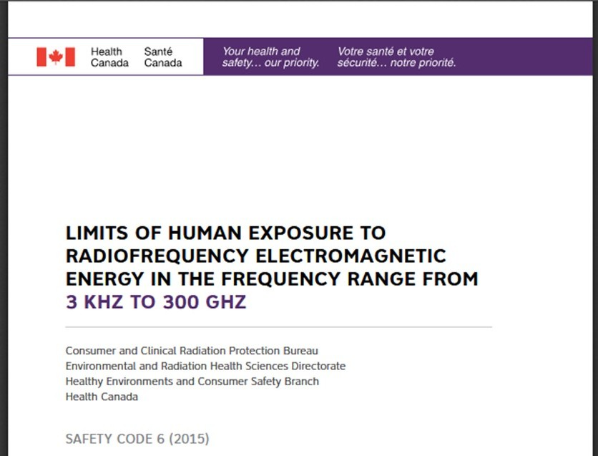
Safety Code 6
Established 1979. Minor revisions 1991, 1993, 1999, 2009, 2015
The purpose is to establish safety limits for human exposure to radiofrequency (RF) fields in the frequency range from 3 kHz to 300 GHz.
Originally intended for individuals working at, or visiting, federally regulated sites.
Health Canada recommends limits for safe human exposure
Health Canada does not regulate the general public's exposure to RF radiation.
Many provinces and territories apply the exposure limits in Safety Code 6 for general public exposure.
Industry, Science and Economic Development Canada (ISED) regulates wireless devices (cell phones, tablets, etc.) and infrastructure (such as cell towers, Wi-Fi) which are required to comply with Safety Code 6.

Slide 16
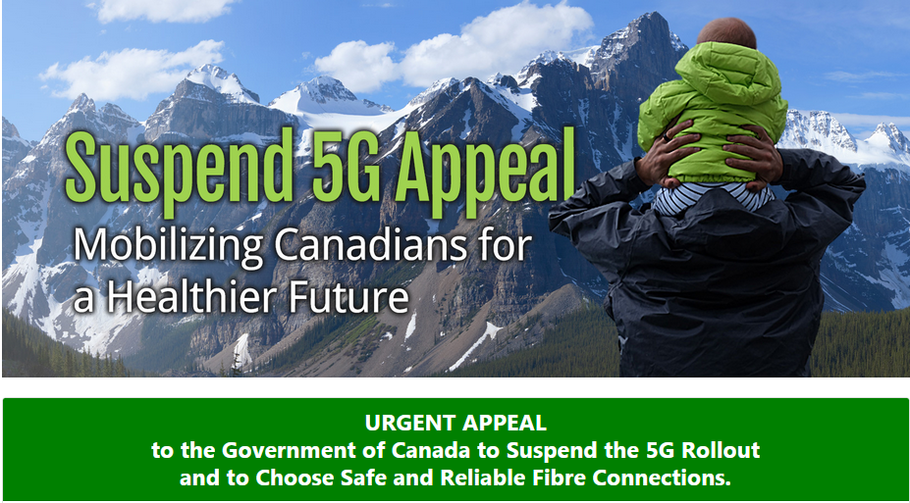

Slide 17
Suspend 5G Canada Appeal
More than 20,600 Canadians have signed

Slide 18
The Precautionary Principle
Where there are threats of serious or irreversible damage to the environment or to human health, lack of full scientific certainty shall not be used as an excuse for postponing the adoption of measures to prevent such environmental and health degradation.

Slide 19
Proof the non-thermal assumption is wrong
2019 - $25m US National Toxicology program study results
https://ntp.niehs.nih.gov/results/areas/cellphones/index.html
2019 - Confirmed by the Ramazzini Institute Study https://www.ncbi.nlm.nih.gov/pubmed/30365129
Belpomme, D., et al. (2018). Thermal and non-thermal health effects of low intensity non-ionizing radiation: https://www.ncbi.nlm.nih.gov/pubmed/30025338
Pall, M. L. (2015). Scientific evidence contradicts findings and assumptions of Canadian Safety Panel 6 https://doi.org/10.1515/reveh-2015-0001
2012 The BioInitiative Report: https://bioinitiative.org/
200 Scientific Studies Reporting Potential Harm at Non-Thermal Levels Below Safety Code 6 Exposure Limits http://c4st.org/?s=200+studies
Notes:
I removed the quote ““Existing guidelines for RF safety only look at thermal tissue damage and are obsolete, since many modern studies show metabolic and genomic damage from exposures below the level of intensity which heats tissues.”
-- American Academy of Environmental Medicine”

Slide 20
Actual Use vs. Tested Emissions
Most industry warnings are buried several layers inside the cell phone
CBC Marketplace “The Secret Inside your Cell Phone” ¹
81% of Canadians have not seen the warning message in their phone or manual
67% of Canadians say they carry their phones in their pocket or directly against their body
All 3 phones tested had emissions 3-4 times above Canada’s guidelines
The National Agency ANFR of France²
Found 90% of the 450 phones tested exceeded guidelines
The % SAR in excess of the recommended distance to against the body ranged from 10% to 25%
Industry states “We meet Federal Guidelines if used correctly”
¹https://www.youtube.com/watch?v=Wm69ik_Qdb8 4.4 million views
²https://ieeexplore.ieee.org/document/8688629

Slide 21
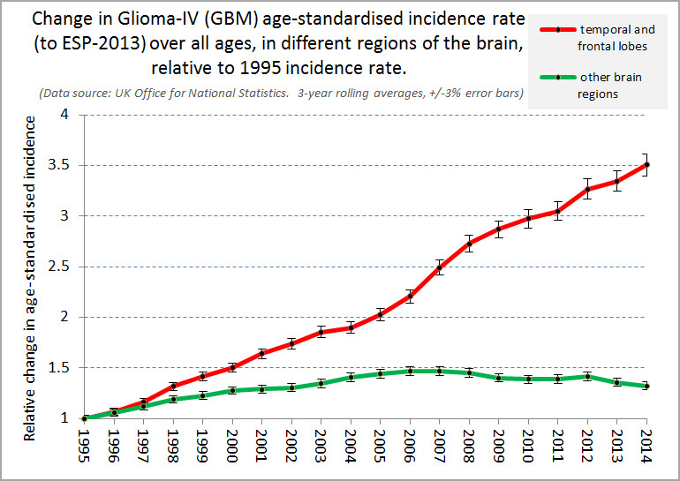
Brain Tumour Cancer Data from the United Kingdom
More tumours in the area of the head close to where cell phones were held
Relative changes
Incidence of tumours in other areas of the head
1995
Year
2014
Modified from Philips et al, 2018

Slide 22
Filling in THE Gaps: Numerous Human Studies Plus … Two large Animal research programs show cancers with RFR
Frequencies and modulations that mimic cellular communications in the USA
Prenatal
Postnatal
Frequencies and modulations that mimic cellular communications in the USA.
2016
1260 rats; mice to be reported
900 MHz; GSM and CDMA
Sacrifice
(106 weeks)
start of treatment
Increased tumours of nerve sheath (Schwannoma in hearts), some evidence of increased gliomas, DNA damage in multiple organs
Frequencies and modulations that mimick common human exposures to base-station antennas globally
Prenatal
Postnatal
2018
2448 rats exposed for 19 h/day
1.8 GHz 0, 5, 25, 50 V/m
Lifespan
start of treatment
50 V/m - Statistically significant increase in nerve sheath tumours in males
Increased nerve sheath pre-cancer (hyperplasia) in males
Increased malignant glial tumours in females
Meg Sears, PhD

Slide 23
NTP Study
10-year, $25 million study
cell phone radiation on 3,000 rodents was tested
Peer reviewed by 11 experts
Highest category “clear evidence of harm”
Ramazzini Study
cell phone radiation on 2,500 rodents were tested
Peer reviewed
Confirmed NTP findings
Magda Havas, PhD
Notes:
National Toxicology Program, National Institute of Environmental Sciences. (2018). Toxicology and carcinogenesis studies in Hsd: Sprague Dawley SD rats exposed to whole-body radio frequency radiation at a frequency (900 MHz) and modulations (GSM and CDMA) used by cell phones. NTP Technical Report 595, 384.
https://www.niehs.nih.gov/ntp-temp/tr595_508.pdf

Slide 24
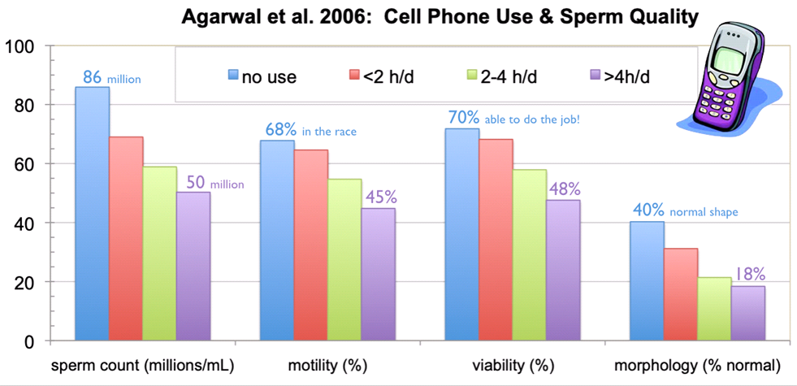
Magda Havas, PhD

Slide 25
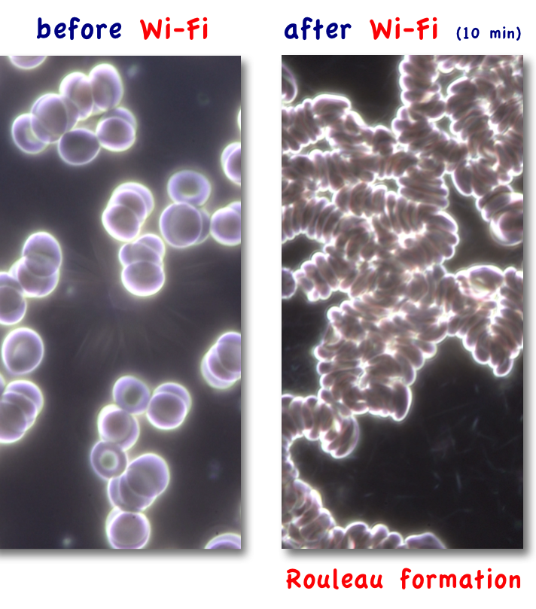
Membranes affected – e.g., live red blood cells
Thick blood
Clots
Heart attack
Stroke
Increasing in younger Canadians
Occurs in some people who are electro-hyper-sensitive
Magda Havas PhD

Slide 26
Insurance Industry Concerns
In 2010, the Emerging Risk Team of Lloyds compared the potential risks from health damage claims to those posed by asbestos
The Swiss Re SONAR Emerging risk insights report, June 2013, listed the “unforeseen consequences of electromagnetic fields” as potentially having a high impact.
The 2019 Swiss Re update report states:
Current concerns regarding potential negative health effects from electromagnetic fields are likely to increase.
Hackers can also exploit 5G speed and volume to acquire (or steal) more data faster.
Major concerns are possible privacy and security breaches, and espionage.

Slide 27
Challenging the Business Case of Wireless Solutions
The Institute for Electrical and Electronics Engineers (IEEE) article¹:
“Wireless technologies will continue to consume at least
10 times more power than wired technologies”
Re-Inventing Wires: The Future of Landlines
and Networks ² states that wireless networks:
Continue to be about 100 times slower than wired systems
Are unreliable, more vulnerable to security and privacy problems and prone to both latency and delay issues
Consume significant amounts of energy and are not sustainable
Can leave people vulnerable in the event of a power grid failure
Increase the points of vulnerability hundreds of thousands of times
Significantly increase the amount of personal and business data at risk
¹https://people.eng.unimelb.edu.au/rtucker/publications/files/energy-wired-wireless.pdf
²http://refhub.elsevier.com/S0360-1323(19)30534-7/sref29

Slide 28
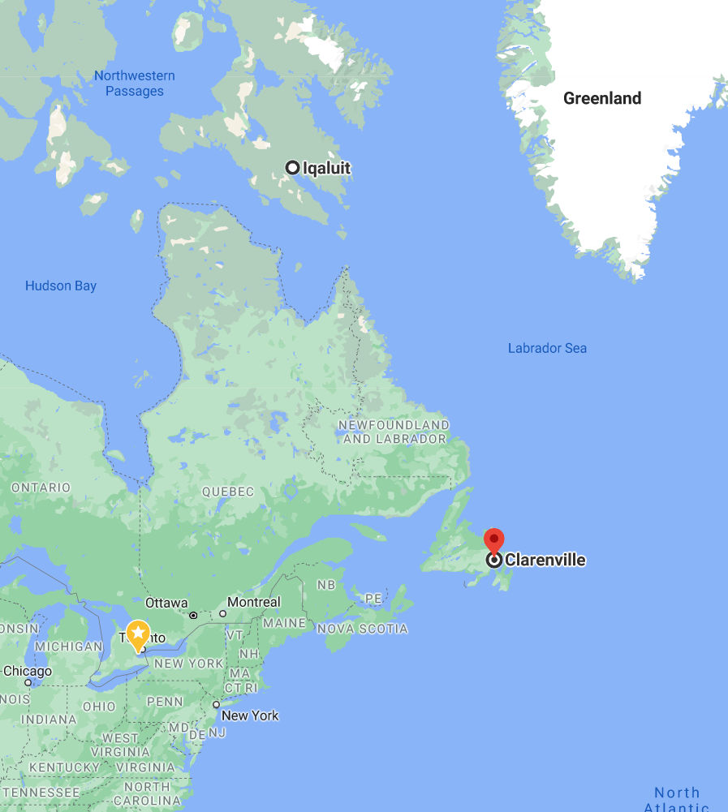
A Wireless Network is Not Better
CanArctic Inuit Networks has announced plans to build a $107M, 2,000 km fibre-optic cable from Newfoundland to Nunavut.¹
COO stated "We've looked at every possible option, route, risk and costs. And we've landed on what is a very realistic plan to get fibre built in the next two years”.
¹ https://www.ctvnews.ca/business/company-plans-to-build-107m-fibre-optic-cable-from-newfoundland-to-nunavut-1.5243445

